Slide 1
Forecasting electricity consumption and production using
ARIMA time series models
Barbu Paul – Gheorghe
Advanced Computing Systems
COORDINATOR: Conf. dr. ing. Árpád GELLÉRT Sibiu, 2019

Slide 2
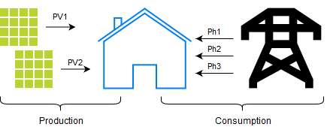
Objectives
Furthering previous research (Feilmeier, Antonescu, Gellert)
Forecasting electrical en. consumption & production

Slide 3
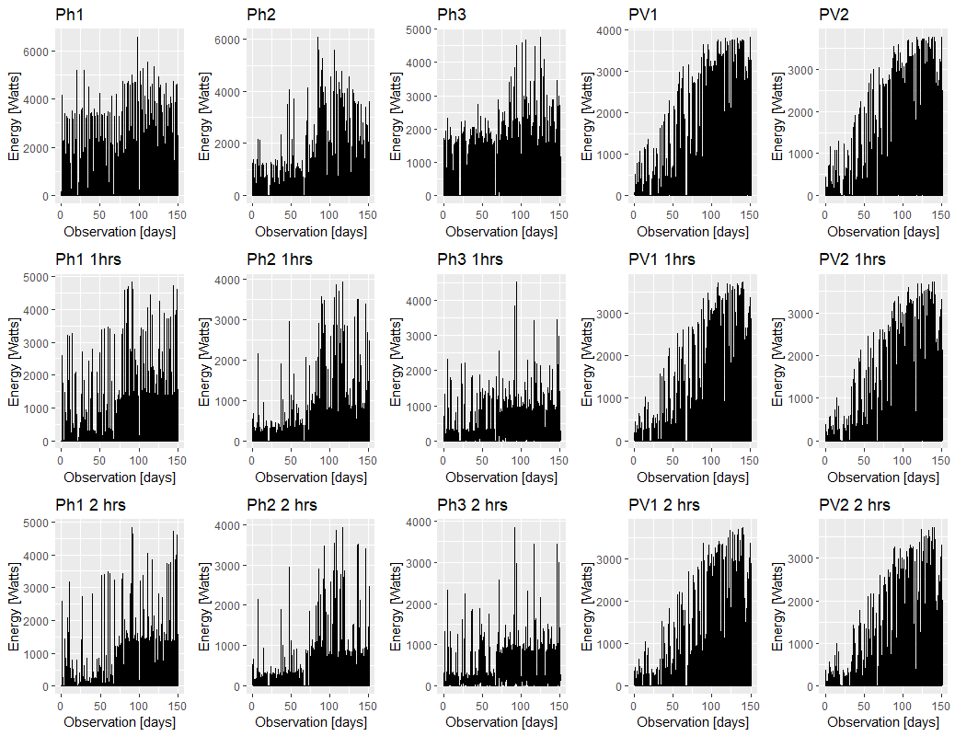

Slide 4
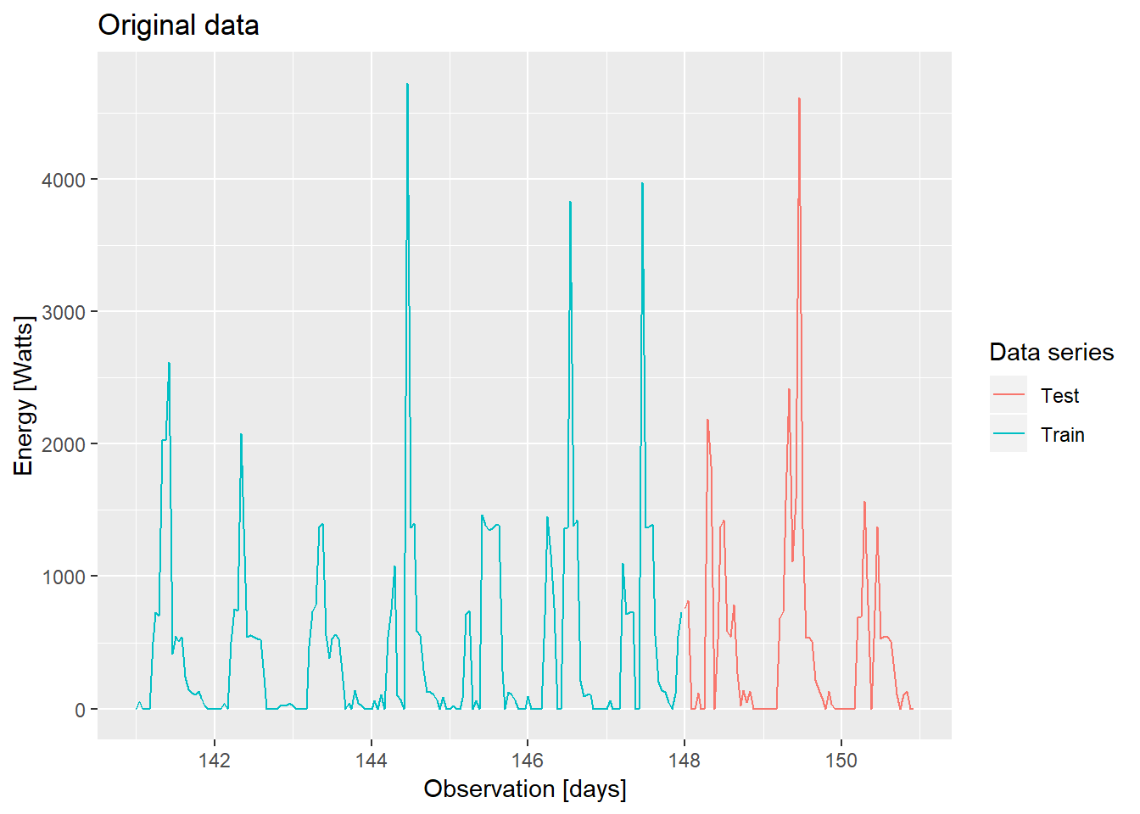
Last 10 days of ph1

Slide 5
AutoRegressive Integrated Moving Average (ARIMA)
Data has to be stationary (statistical properties constant over time)
ARIMA(p, d, q)
ARIMA(p, d, q)(P, D, Q)[m]
AutoCorrelation Function (ACF)
Partial AutoCorrelation Function (PACF)
Residuals
phi - AR coefficients
theta - MA coefficients
epsilon - errors

Slide 6
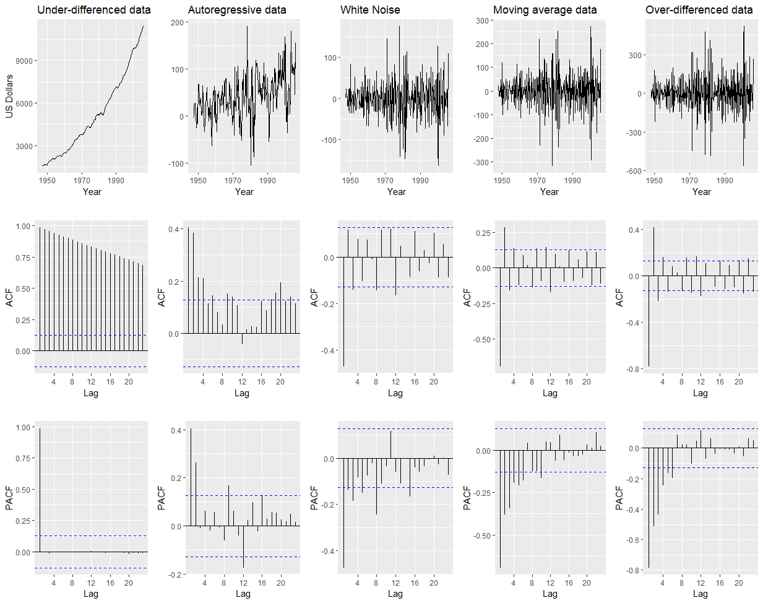
Notes:
Quarterly US GDP - Gross Domestic Product - Produs Intern Brut

Slide 7

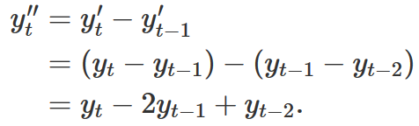
I(d)
Integrated - the opposite of differencing
The algorithm differences the data, hence it has to be “integrated” when we start

Slide 8
AR(p)
p - how many previous values affect this one
phi - in what proportion does the previous value affect the present one
ACF - decaying or sinusoidal - we do have correlation between several lags
PACF - critical at lag p - up to which lag the correlation is significant

Slide 9
MA(q)
q - how many previous errors affect this value
epsilon - in what proportion does the previous errors affect the present value
ACF - critical at lag q - up to which lag the correlation is significant
PACF - decaying or sinusoidal - we do have correlation between several lags

Slide 10
ARIMAX
x - external regressors
beta - external regressors coefficient
External regressors:
Seasonal dummies: quarter, month, events, etc.
Dummies: trend, time, etc.
Fourier terms

Slide 11
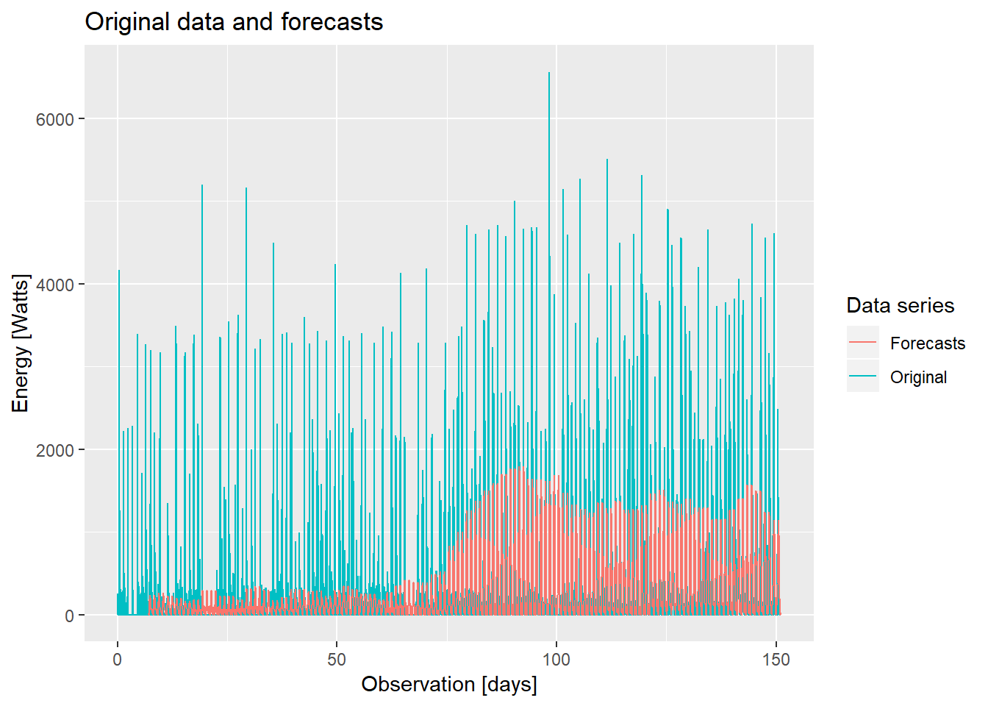
ph1
7 training days
2 forecast days
ARIMA(1, 0, 0)
2 Fourier terms
11:00 - 12:00
MAE = 218.04

Slide 12
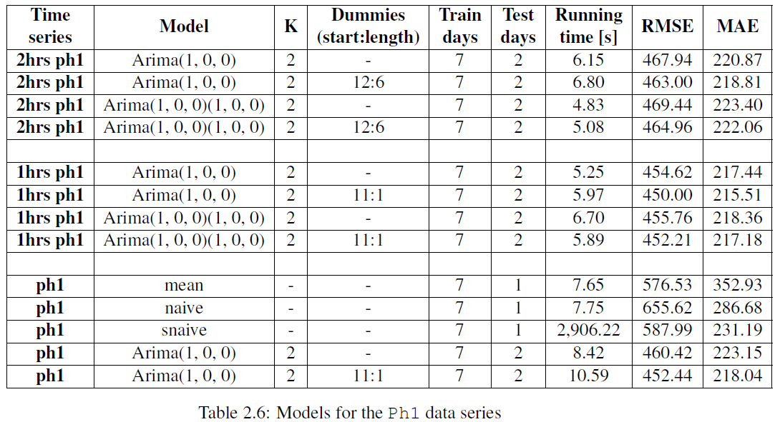
5min vs subsampled data

Slide 13
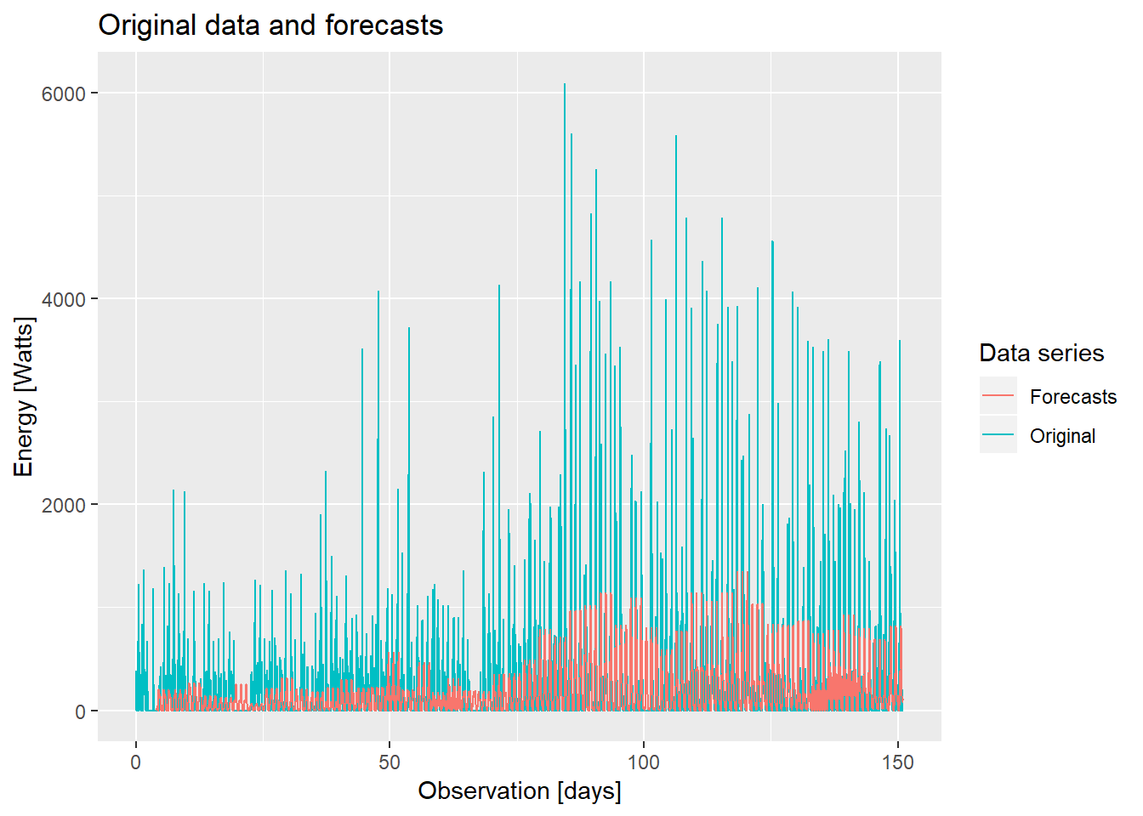
ph2
4 training days
3 forecast days
ARIMA(1, 0, 0)
3 Fourier terms
08:00 - 11:00
MAE=161.40

Slide 14
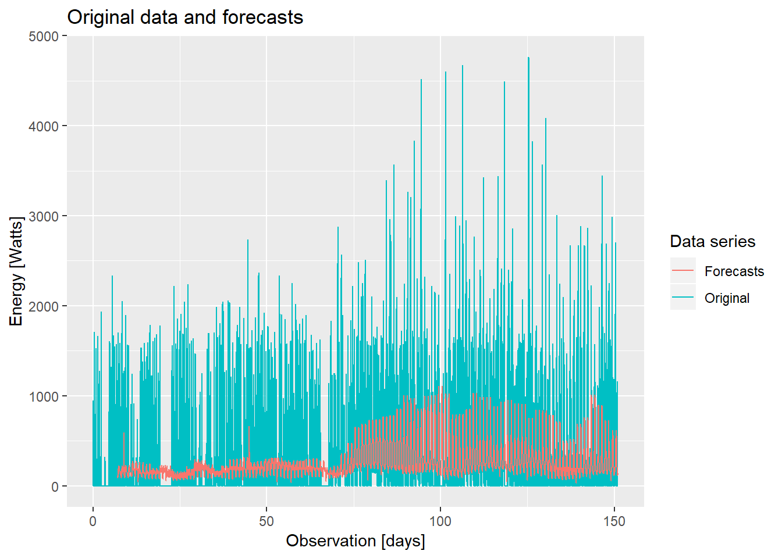
ph3
7 training days
2 forecast days
ARIMA(1, 0, 0)
2 Fourier terms
09:00 - 11:00
MAE = 183.96

Slide 15
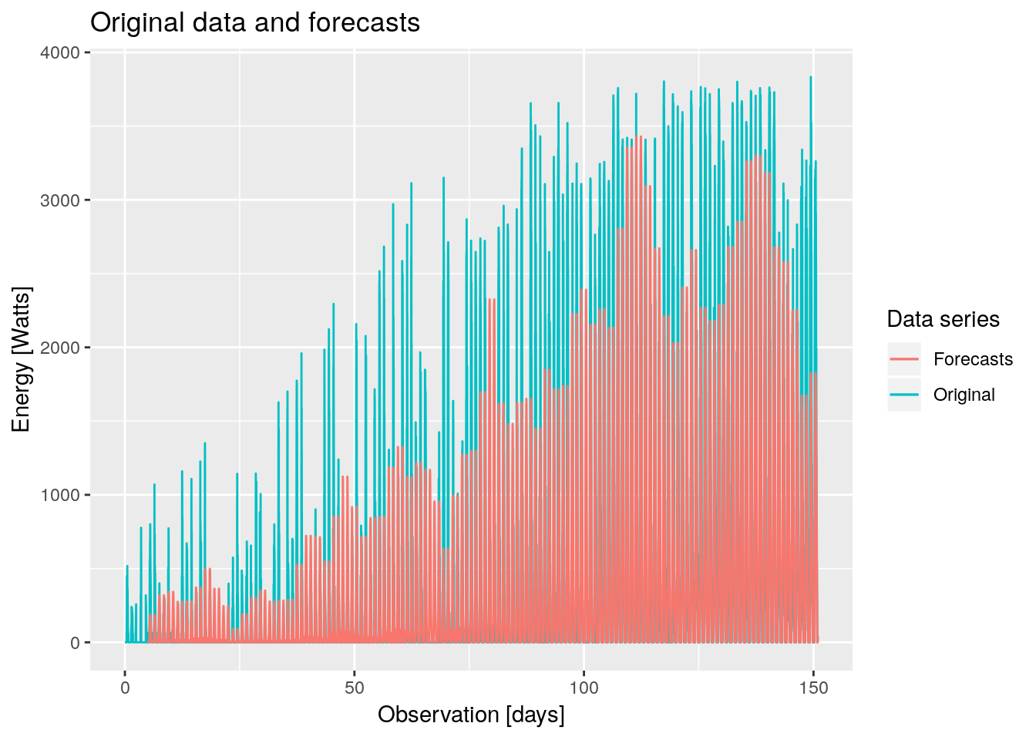
PV1
5 training days
2 forecast days
ARIMA(1, 0, 0)
3 Fourier terms
11:00 - 17:00
MAE = 225.91

Slide 16
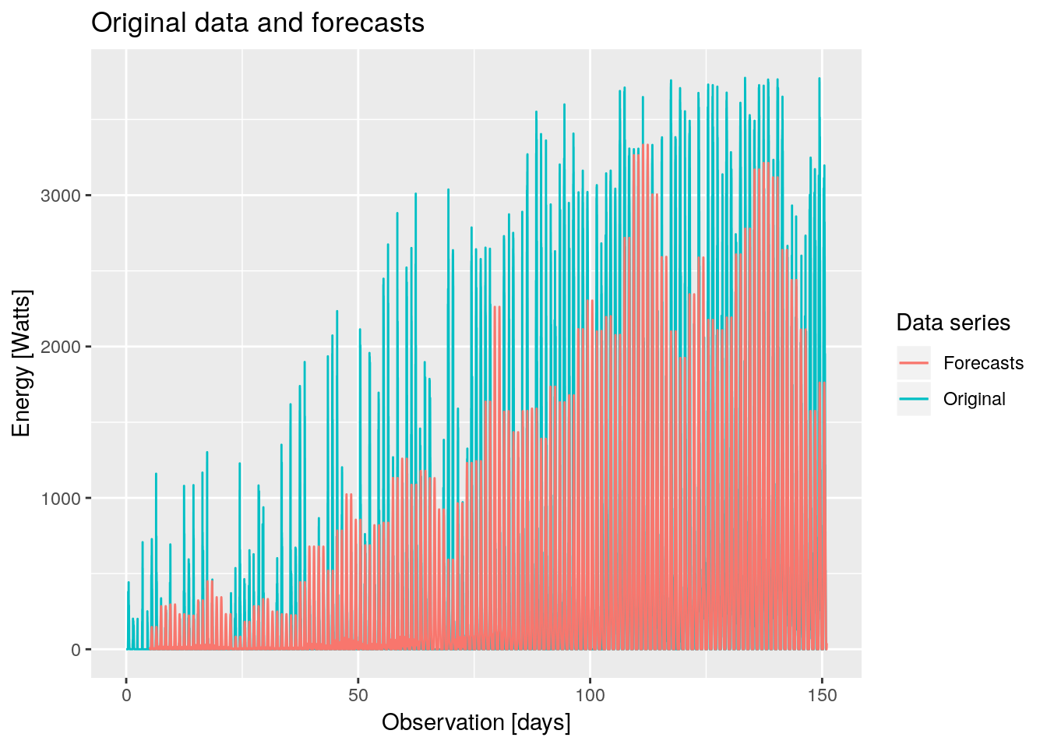
PV2
5 training days
2 forecast days
ARIMA(1, 0, 0)
3 Fourier terms
MAE = 220.00

Slide 17
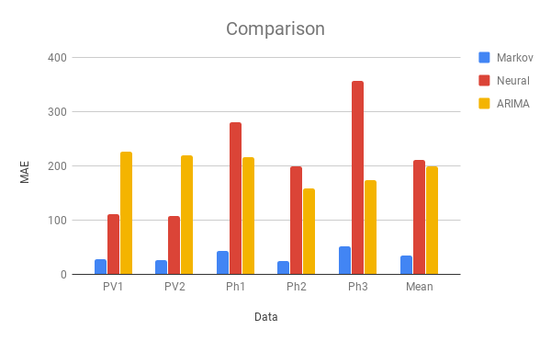
ARIMA vs Markov vs Neural

Slide 18
Benchmark vs ARIMA on the ph3 data
Benchmark vs ARIMA on the PV1 data
Method | naive | meanf | snaive | ARIMA (1, 0, 0) 2 Fourier terms | ARIMA (1, 0, 0) 2 Fourier terms 09:00 to 11:00 dummies
MAE | 215.26 | 216.88 | 218.67 | 187.96 | 183.96
Method | naive | meanf | snaive | ARIMA (1, 0, 0) 2 Fourier terms | ARIMA (1, 0, 0) 2 Fourier terms 16:00 to 20:00 dummies | ARIMA (1, 0, 0) 3 Fourier terms 11:00 to 17:00 dummies
MAE | 445.33 | 516.38 | 262.57 | 238.26 | 237.10 | 225.91

Slide 19
Conclusions
Only short periods of time can be predicted
PV1, PV2 data sets are time-of-day correlated
ARIMA is time consuming, simpler methods exist
ARIMA models are not very suited for high frequency data

Slide 20
Future work
Downsampling with interval averages instead of snapshots
Automating the predictions for industry use
Alternative algorithms: bats, tbats, ETS.

Slide 22

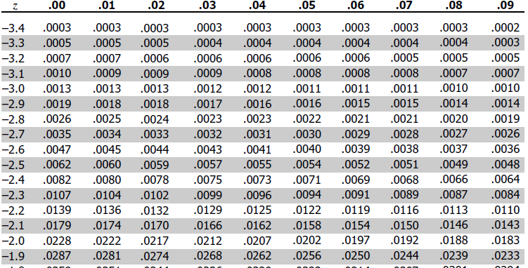
Critical values for ACF & PACF
Z distribution and p values
95% confidence interval - Z=1.96
(P)ACF critical value (two std. dev. - assume an almost stationary series)

Slide 23
Differences

Slide 24
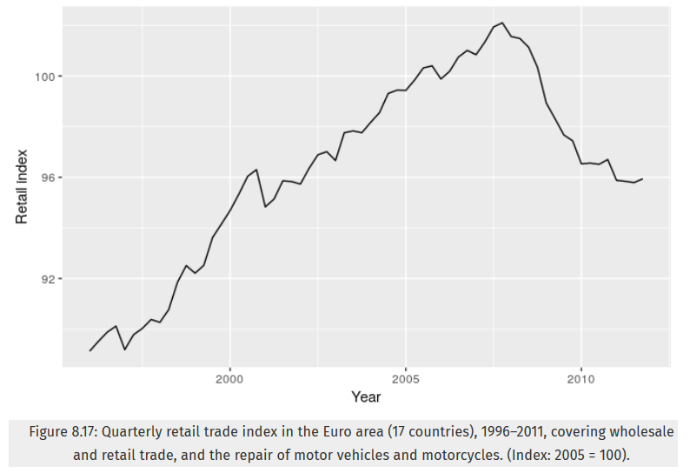
Notes:
Retail index - a measure of inflation

Slide 25
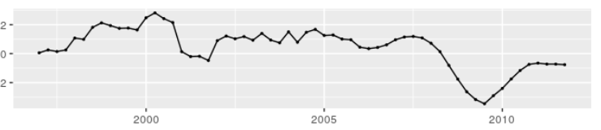
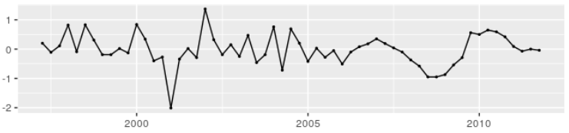
Quaterly data
D=1
D=1 & d=1

Slide 26
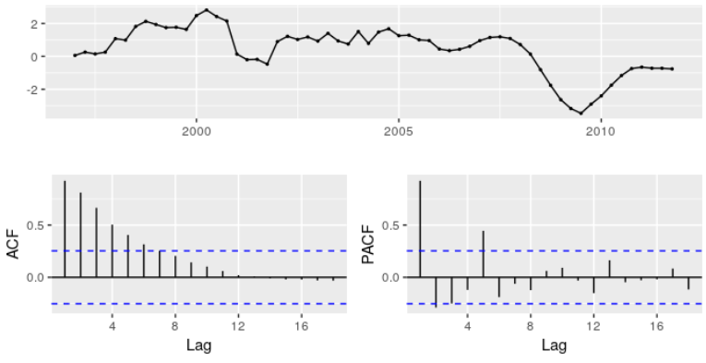
AR(2)

Slide 27
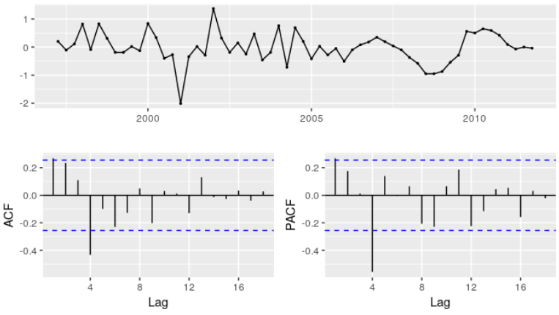
MA(1) and SMA(1)

